Slide 1
Search As A Metaphor For Learning
Litty Tressa George

Slide 2
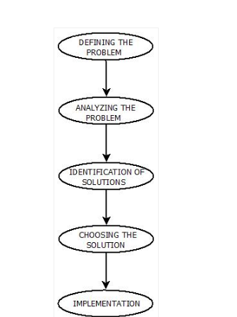
Problem Solving Steps
The process of solving a problem consists of five steps. These are:

Slide 3
Search
Search is a method that can be used by computers to examine a problem space in order to find a goal.
In general, searching refers to as finding target information or goal that is aimed.
Searching is of the most commonly used technique of problem solving in artificial intelligence.
The searching algorithms helps us to search for solutions that exist in the problem space.

Slide 4
Search Terminology
Problem Space − It is the environment in which the search takes place. (A set of states and set of operators to perform operations/actions to change those states) A problem space can also be considered to be a search space.
Problem Space Graph − It is the graphical representation of problem states. States are shown by nodes and operators are shown by edges.
Depth of a problem − Length of a shortest path or shortest sequence from initial State to goal state.

Slide 5
Space Complexity − The space complexity is related to the amount of memory that the method uses to store its specific information.
Time Complexity − The time complexity of a method is related to the length of time that the method would take to find a goal state
Admissibility − A property of an algorithm to always find an optimal solution.
Branching Factor − The average number of child nodes in the problem space graph.
Completeness- A search method is described as being complete if it is guaranteed to find a goal state if one exists.

Slide 6
Search Strategy
Searching is a process to find the solution for a given set of problems.
This in artificial intelligence can be done by using either uninformed searching strategies of either informed searching strategies.
Un-Informed Search Strategy
Informed Search Strategy

Slide 7
Un-Informed Search Strategy
Uninformed search is a class of general-purpose search algorithms which operates in brute force-way.
Uninformed search algorithms do not have additional information about the problem domain other than Initial state & Goal state description , so it is also called blind search.
Un-Informed search strategy includes two basic search techniques. These are:
Breadth First Search.
Depth First Search
Depth-first search and breadth-first search are the best-known and widest-used search methods.

Slide 8
Following are the various types of uninformed search algorithms
Breadth-first Search
Depth-first Search
Depth-limited Search
Iterative deepening depth-first search
Uniform cost search
Bidirectional Search

Slide 9
Breadth-first search
Breadth-first search is the most common search strategy for traversing a tree or graph.
This algorithm searches breadthwise in a tree or graph, so it is called breadth-first search.
BFS algorithm starts searching from the root node of the tree and expands all successor node at the current level before moving to nodes of next level.
The breadth-first search algorithm is an example of a general-graph search algorithm.
Breadth-first search implemented using FIFO queue data structure.

Slide 10
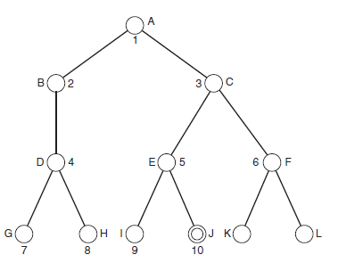
BFS – Order of Search:
Illustrating breadth-first search. The numbers indicate the order in which the nodes are examined.

Slide 11
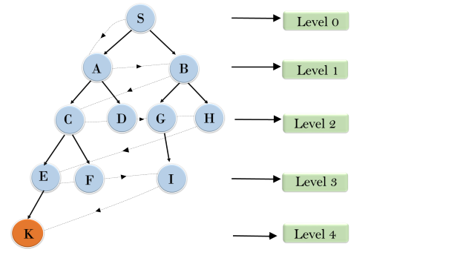

BFS Example

Slide 12


Properties of BFS
Time Complexity: Time Complexity of BFS algorithm can be obtained by the number of nodes traversed in BFS until the shallowest node. Where the d= depth of shallowest solution and b is a node at every state.
Space Complexity: Space complexity of BFS algorithm is given by the Memory size of frontier which is
Completeness: BFS is complete, which means if the shallowest goal node is at some finite depth, then BFS will find a solution.
Optimality: BFS is optimal if path cost is a non-decreasing function of the depth of the node.

Slide 13
Advantages of BFS:
BFS will provide a solution if any solution exists.
If there are more than one solutions for a given problem, then BFS will provide the minimal solution which requires the least number of steps.

Slide 14
Disadvantages of BFS:
It requires lots of memory since each level of the tree must be saved into memory to expand the next level.
BFS needs lots of time if the solution is far away from the root node.

Slide 15
Depth-first search
Depth-first search is a recursive algorithm for traversing a tree or graph data structure.
It is called the depth-first search because it starts from the root node and follows each path to its greatest depth node before moving to the next path.
DFS uses a stack data structure for its implementation.
Assuming that we start from the left side and work toward the right, depth-first search involves working all the way down the left-most path in the tree until a leaf node is reached.
If this is a goal state, the search is complete, and success is reported.
If the leaf node does not represent a goal state, search backtracks up to the next highest node that has an unexplored path.
Depth-first search is an example of brute-force search, or exhaustive search.

Slide 16
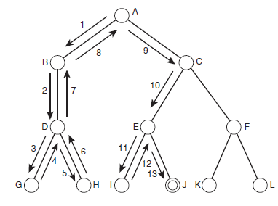
DFS – Order of Search
In the below search tree, shows the order of depth-first search, and search will follow the order as the arrow indicates.

Slide 17
DFS - Search Principle:
In the previously considered search tree, after examining node G and discovering that it is not a goal node, search will backtrack to node D and explore its other children.
In this case, it only has one other child, which is H. Once this node has been examined, search backtracks to the next unexpanded node, which is A, because B has no unexplored children.
This process continues until either all the nodes have been examined, in which case the search has failed, or until a goal state has been reached, in which case the search has succeeded.
In the Figure , search stops at node J, which is the goal node.
As a result, nodes F, K, and L are never examined.

Slide 18

Properties of DFS
Completeness: DFS search algorithm is complete within finite state space as it will expand every node within a limited search tree.
Time Complexity: Time complexity of DFS will be equivalent to the node traversed by the algorithm. It is given by:
Where, m= maximum depth of any node and this can be much larger than d (Shallowest solution depth)
Space Complexity: DFS algorithm needs to store only single path from the root node, hence space complexity of DFS is equivalent to the size of the fringe set, which is
Optimality: DFS search algorithm is non-optimal, as it may generate a large number of steps or high cost to reach to the goal node.

Slide 19
Advantage
DFS requires very less memory as it only needs to store a stack of the nodes on the path from root node to the current node.
It takes less time to reach to the goal node than BFS algorithm (if it traverses in the right path).

Slide 20
Disadvantages
In particular, if a branch of the search tree is extremely large, or even infinite, then the search algorithm will spend an inordinate amount of time examining that branch, which might never lead to a goal state.
Note: The problem of infinite paths can be avoided in depth-first search by applying a depth threshold. This means that paths will be considered to have terminated when they reach a specified depth. This has the disadvantage that some goal states (or, in some cases, the only goal state) might be missed but ensures that all branches of the search tree will be explored in reasonable time.

Slide 21
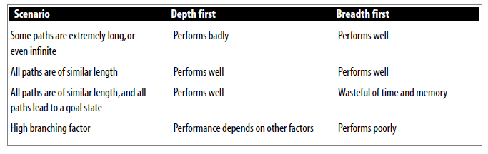
Comparison of depth-first and breadth-first search

Slide 22
Among these, which search strategy is used so widely to solve everyday computer problems ? & why?

Slide 23
Depth-first search is usually simpler to implement than breadth-first search, and it usually requires less memory usage because it only needs to store information about the path it is currently exploring, whereas breadth-first search needs to store information about all paths that reach the current depth.
This is one of the main reasons that depth-first search is used so widely to solve everyday computer problems.

Slide 24
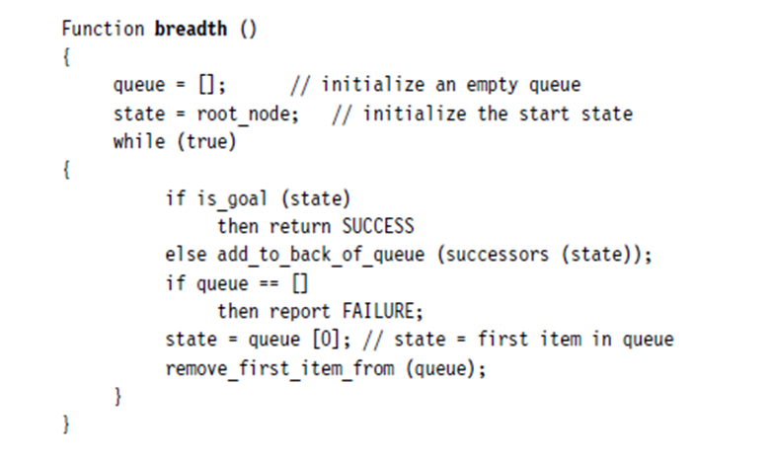
Implementation of BFS
The following is the pseudocode implementation of breadth-first search

Slide 25
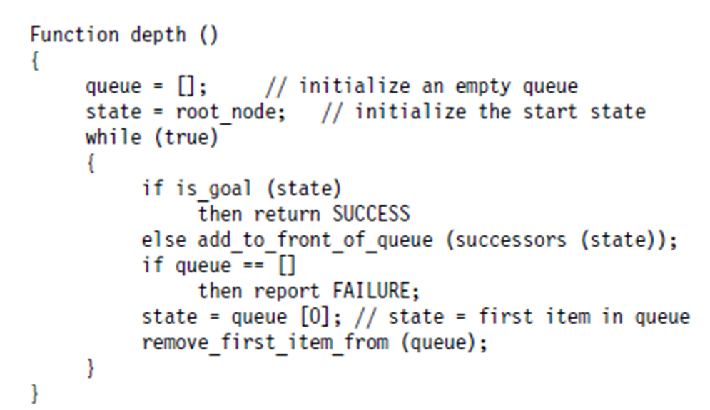
Implementation of DFS
The following is the pseudocode implementation of depth-first search

Slide 26
Depth-limited Search
A depth-limited search algorithm is similar to depth-first search with a predetermined limit.
Depth-limited search can solve the drawback of the infinite path in the Depth-first search.
In this algorithm, the node at the depth limit will treat as it has no successor nodes further thus the search ends.
Depth-limited search can be terminated with two Conditions of failure:
Standard failure value: It indicates that problem does not have any solution.
Cutoff failure value: It defines no solution for the problem within a given depth limit.

Slide 27
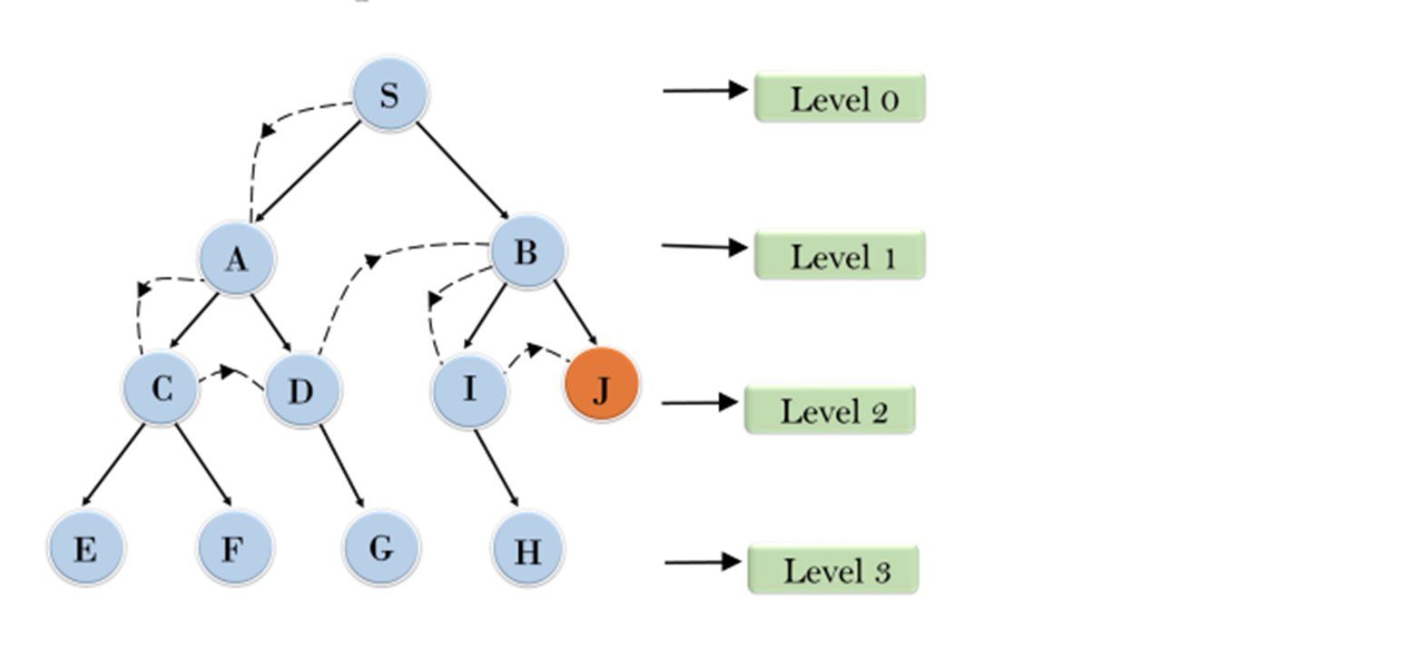
Example

Slide 28
Advantages:
Depth-limited search is Memory efficient.
Disadvantages:
Depth-limited search also has a disadvantage of incompleteness.
It may not be optimal if the problem has more than one solution.

Slide 29
Properties of DLS
Completeness: DLS search algorithm is complete if the solution is above the depth-limit.
Time Complexity: Time complexity of DLS algorithm is O(b^{ℓ}).
Space Complexity: Space complexity of DLS algorithm is O(b×ℓ).
Optimal: Depth-limited search can be viewed as a special case of DFS, and it is not optimal even if ℓ>d , else optimal i.e. if ℓ<d.

Slide 30
Uniform Cost Search
Uniform-cost search is a searching algorithm used for traversing a weighted tree or graph.
This algorithm comes into play when a different cost is available for each edge.
The primary goal of the uniform-cost search is to find a path to the goal node which has the lowest cumulative cost.
Uniform-cost search expands nodes according to their path costs form the root node.
It can be used to solve any graph/tree where the optimal cost is in demand.
A uniform-cost search algorithm is implemented by the priority queue. It gives maximum priority to the lowest cumulative cost.
Uniform cost search is equivalent to BFS algorithm if the path cost of all edges is the same.

Slide 31
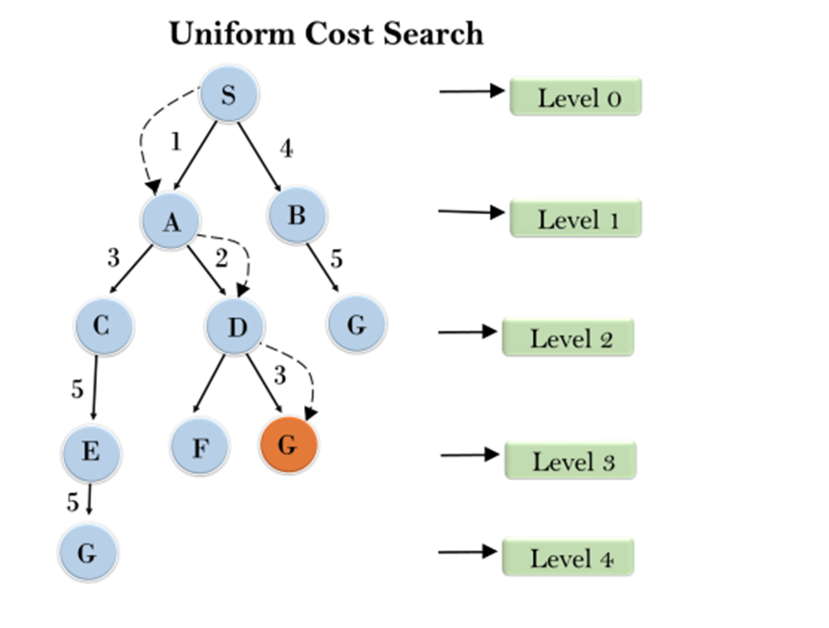
Example UCS

Slide 32
Advantages:
Uniform cost search is optimal because at every state the path with the least cost is chosen.
Disadvantages:
It does not care about the number of steps involve in searching and only concerned about path cost. Due to which this algorithm may be stuck in an infinite loop.

Slide 33
Properties of UCS
Completeness:
Uniform-cost search is complete, such as if there is a solution, UCS will find it.
Time Complexity:
Let C* is Cost of the optimal solution, and ε is each step to get closer to the goal node. Then the number of steps is = C*/ε+1. Here we have taken +1, as we start from state 0 and end to C*/ε.
Hence, the worst-case time complexity of Uniform-cost search is O(b^{1 + [C*/ε]}).
Space Complexity:
The same logic is for space complexity so, the worst-case space complexity of Uniform-cost search is O(b^{1 + [C*/ε]}).
Optimal:
Uniform-cost search is always optimal as it only selects a path with the lowest path cost

Slide 34
Iterative Deepening Depth-First Search (IDDFS)
Depth-First Iterative Deepening, or DFID (also called Iterative Deepening Search or IDS), is an exhaustive search technique that combines depth-first with breadth-first search.
The DFID algorithm involves repeatedly carrying out depth-first searches on the tree, starting with a depth-first search limited to a depth of one, then a depth-first search of depth two, and so on, until a goal node is found.
That is DFS is applied to the root node, if it is not goal node move to the next level and continue applying dfs in next level
Each level is visited in each iteration.

Slide 35
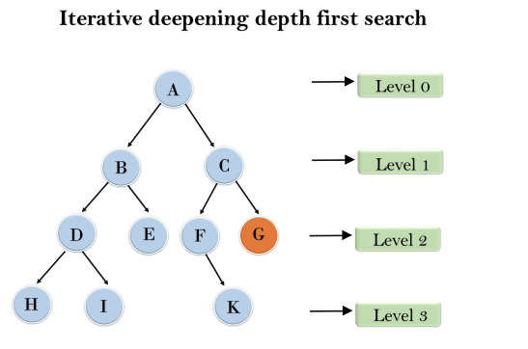
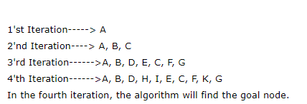
Example
Following tree structure is showing the iterative deepening depth-first search. IDDFS algorithm performs various iterations until find the goal node. The iteration performed by the algorithm is given as
Note: In the 3rd iteration itself algorithm finds the goal node G. It can be set to stop at finding the initial solution or can be set to search the search tree fully to find other solutions if any exist.

Slide 36
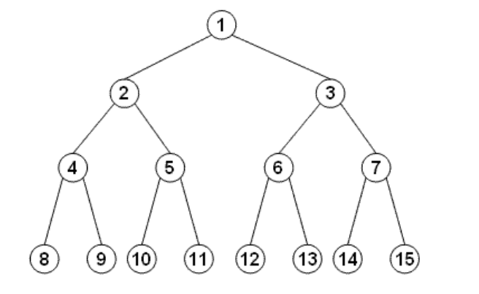
QUESTION 1
For the following Search space ,suppose the goal state is 11. List the order in which nodes will be visited for breadth-first search, depth-limited search with limit 3, and iterative deepening search

Slide 37
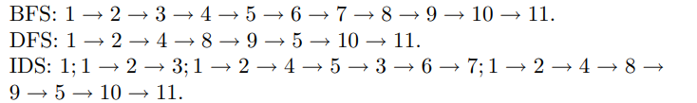
SOLUTION

Slide 38
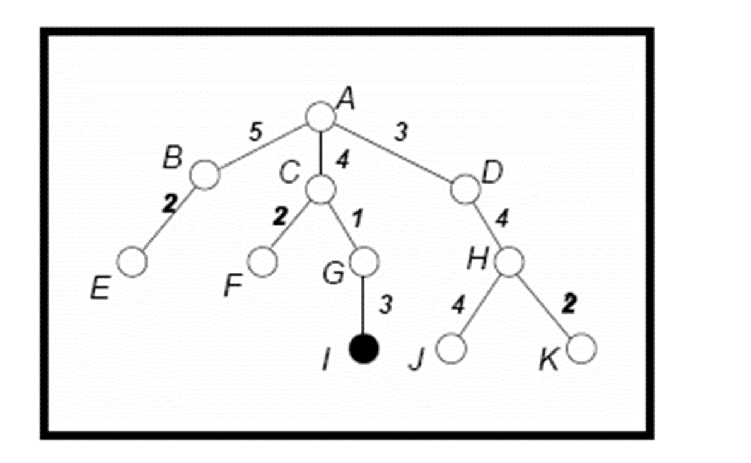
QUESTION 2
For the following tree, show the order of nodes visited for breadth-first search, depth-first search, uniform cost search, and iterative deepening search . The goal node is I and the numbers next to the edges indicate the associated cost

Slide 39
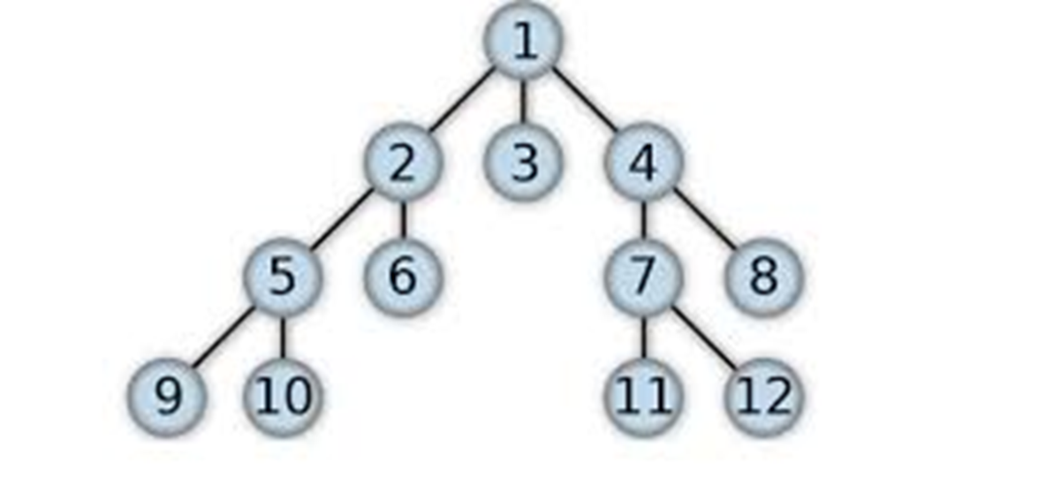
QUESTION 2
For the following tree, show the order of nodes visited for breadth-first search, depth-first search, depth limited search (l=3), and iterative deepening search

